Slide 1
Friday 19th June 2020 Session 5
E-mail us on:
Year5@fva.clf.uk
Year6@fva.clf.uk

Slide 2
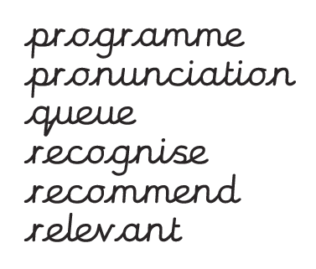
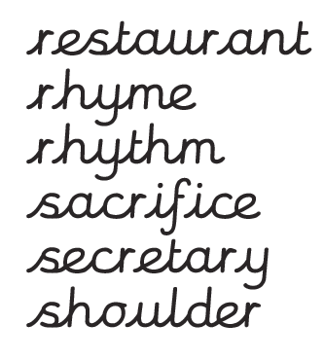
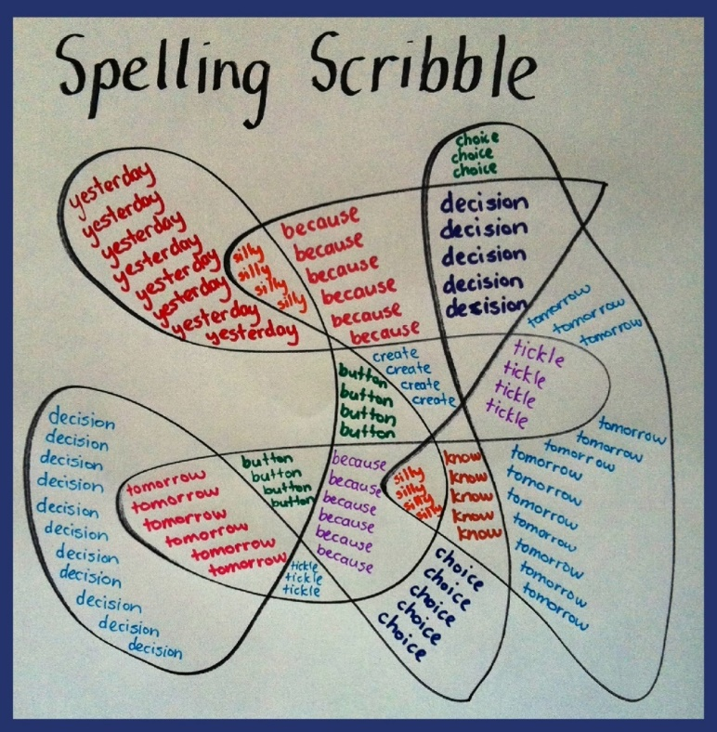
Spelling
Please practise these spelling words by:
-Completing a spelling scribble

Slide 3
We are learning to use ‘ed’ fronted adverbials.
This term, we have a new text – The Rabbits by John Marsden and Shaun Tan.
Today, we are going to practise writing sentences with ‘ed’ fronted adverbials to write sentences linked to an image from the book.

Slide 4
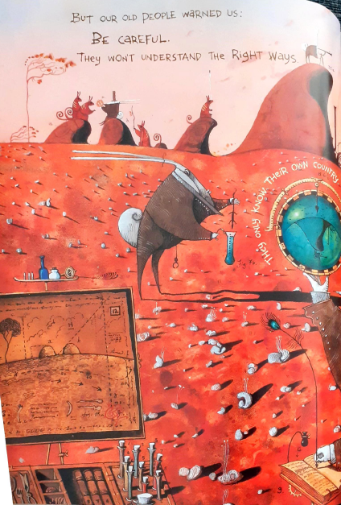
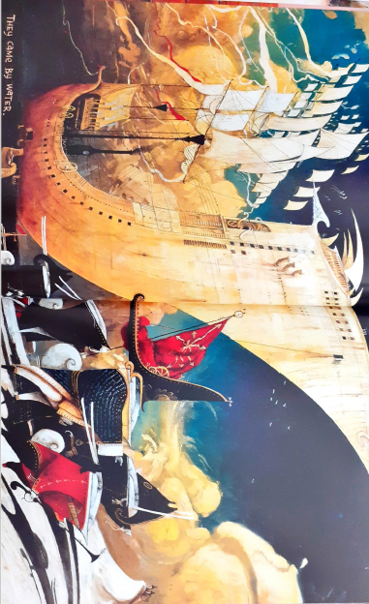
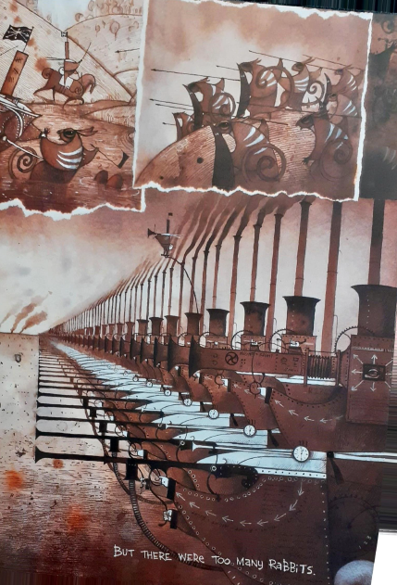
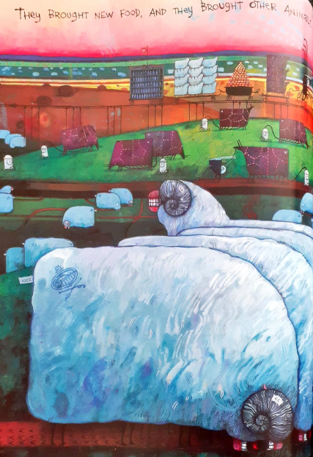
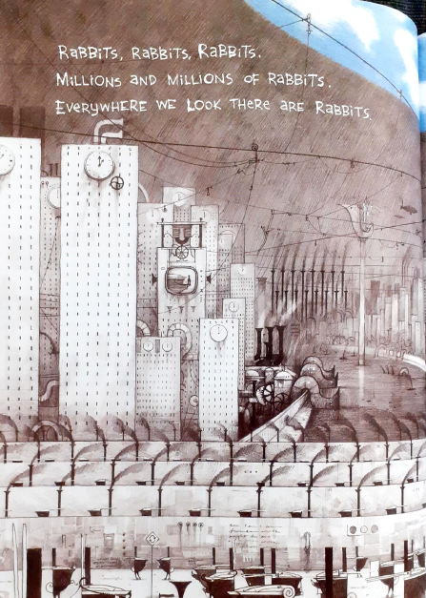
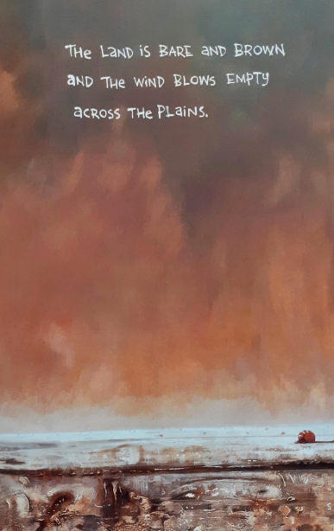
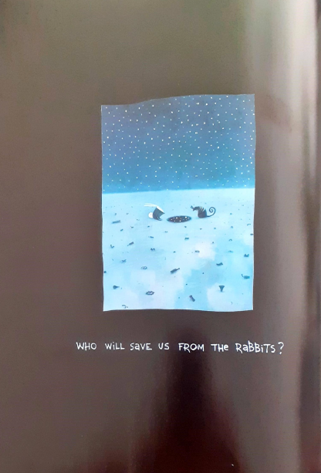
Can you use these images to retell the story? You might want to have the book PDF or video open for this.

Slide 5
We are learning to use ‘ed’ fronted adverbials.
When you want to write about why or how a character is reacting to something that happening, you might use
powerful verbs. For example:
This is a clever way of focusing attention on the emotions of the character. It provides the reader with important and useful information about the action and helps your writing to flow more smoothly.
Jonah was astonished by her reaction to his gift. He left the house with the puppy.
Martha looked cautiously over the wall. She was terrified the old man would see her.

Slide 6
Using an ‘ed’ sentence
But you can place more emphasis on the feelings and emotions of the character by joining the sentences together and beginning with the powerful ‘ed’ verb. For example:
Astonished by her reaction to his gift, Jonah left the house with the puppy.
Terrified the old man would see her, Martha looked cautiously over the wall.
Notice where a comma has been used to indicate a pause when reading the sentence. You need to remember to put the comma at the end of the ‘ed’ verb phrase.

Slide 7
Your turn
Add the comma to the correct place in these ‘ed’ sentences.
Stretched across the corner of the doorway the spider’s web hung gracefully.
Awakened by the strange sound the dog began to bark loudly.
Delighted by her lottery win mum offered to take us all out for pizza.
Pleased to be home dad knocked the snow from his boots and stepped into the warm house.
Destroyed by fire the village was no longer a bustling community.

Slide 8
Your turn
Add an ‘ed’ word or phrase to the beginning of these short sentences. Remember to change the capital letter and add a comma.
…………………… She watched as the dogs began to fight with each other.
…………………… The runner sank to the floor with pain.
…………………… The band got up on stage to sing their latest hit song.
…………………… Ruth asked the teacher to explain the homework.

Slide 9
Your turn
Add a main clause to complete these ‘ed’ sentences.
Notice where a comma has been added.
Trapped by the incoming tide, ....................
Astonished by her words, ....................
Petrified she would fall, ....................
Worried about the test, ....................
Surprised by the enormous bang, ....................
Amazed, ....................

Slide 10
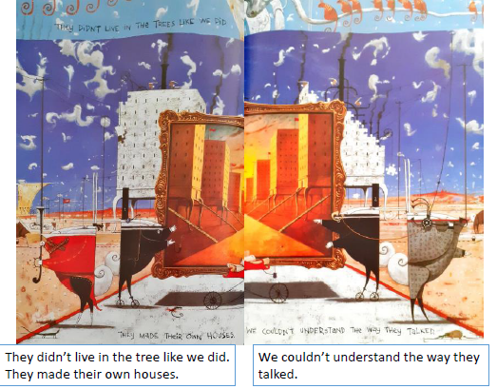
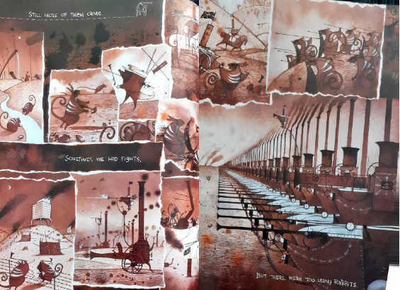
Your turn
Try using some of these words to write ‘ed’ sentences.
Write some sentences about these images using just the one word and other sentences with extra words added to make a longer ‘ed’ clause. Don’t forget the comma!
horrified amazed shocked
transfixed enthralled surprised
situated excited drenched
confused mesmerised cheated
For example:
Confused, my friends and family watched them explore our land and build their homes.
Destroyed by the intruders, our home was no longer a safe haven.

