Slide 1
Teaching Notes
This week your child is revisiting and learning to…
Read text and answer comprehension questions with a focus on retrieval and order words in order to make a meaningful sentence.
Do this by…
Completing the challenges in the PowerPoint.
Practise for a short time each day (15-20 mins).
Link the learning to your reading books on Bug Club and at home.

Slide 2
Monday
Reading

Slide 3
Monday
Today child is revisiting and learning to…
Listen carefully to an information book and retrieve information.
Do this by…
Listening carefully to the information book.
Read the comprehension questions and retrieve information from the text.
Order a sentence to make it make sense.

Slide 4
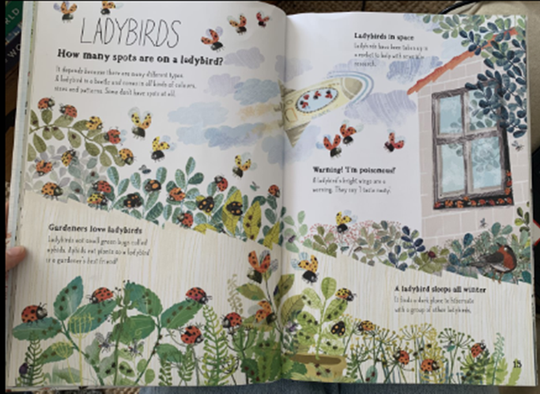
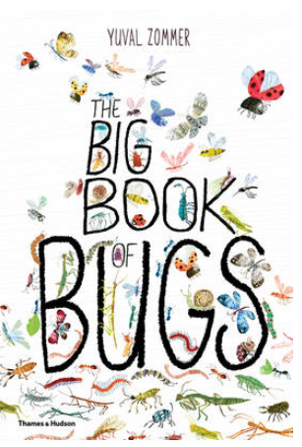
Challenge 1
Listen to the information and look at the pictures in the book.

Slide 5
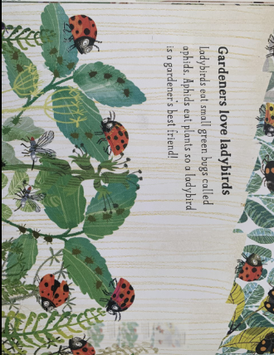
Challenge 2
Support your child to read (or/ and listen to) the text. Encourage your child to revisit the text after reading the question.
Why do gardeners love aphids?

Slide 6
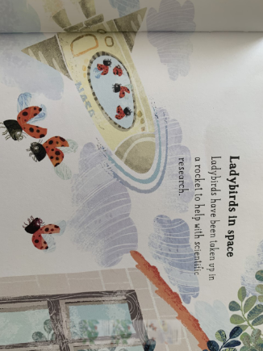
Challenge 3
Support your child to read (or/ and listen to) the text. Encourage your child to revisit the text after reading the question.
Tick the box that is true.
Ladybirds have been:
In the snow
Space
Under the sea

Slide 7
Challenge 4
Support your child to build a sentence using the words below. If it helps, you could write the words on pieces of paper so that your child can move them around to build the sentence physically.
Ladybirds
bright
wings
are
a
warning.

Slide 8
Challenge 4
Support your child to check if their sentence makes sense.

Slide 9
Tuesday
Reading

Slide 10
Tuesday
Today child is revisiting and learning to…
Listen carefully to an information book and retrieve information.
Do this by…
Listening carefully to the information book.
Read the comprehension questions and retrieve information from the text.
Order a sentence to make it make sense.

Slide 11
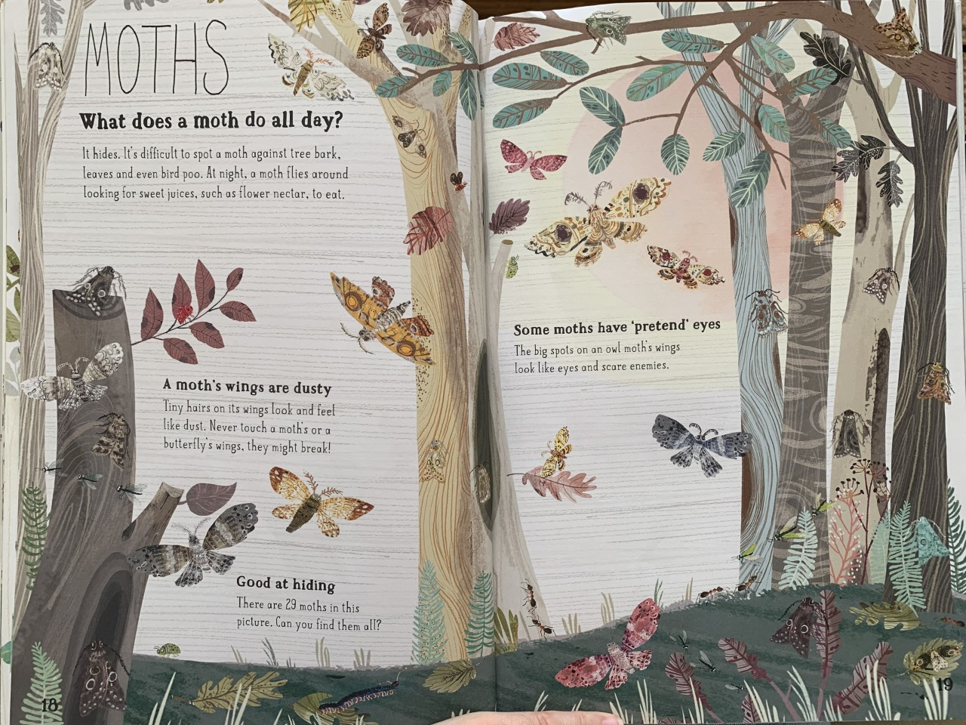
Challenge 1
Listen to the information and look at the pictures in the book.

Slide 12
Challenge 2
Support your child to read (or/ and listen to) the text. Encourage your child to revisit the text after reading the question.
What does a moth do at night?

Slide 13
Challenge 3
Support your child to read (or/ and listen to) the text. Encourage your child to revisit the text after reading the question.
Tick the box that is true.
Moths wings are covered in
Tiny hairs
Dust
Fur

Slide 14
Challenge 4
Support your child to read (or/ and listen to) the text. Encourage your child to revisit the text after reading the question.
Why do owl moths want to scare animals?

Slide 15
Wednesday
Reading

Slide 16
Wednesday
Today child is revisiting and learning to…
Listen carefully to an information book and retrieve information.
Do this by…
Listening carefully to the information book.
Read the comprehension questions and retrieve information from the text.
Order a sentence to make it make sense.

Slide 17
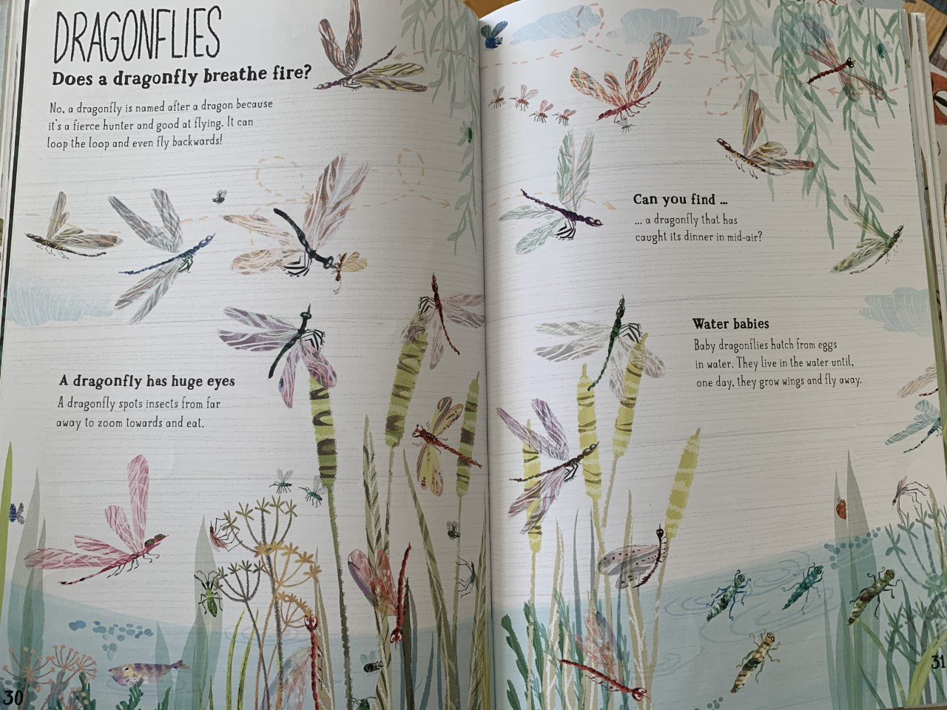
Challenge 1
Listen to the information and look at the pictures in the book.

Slide 18
Challenge 2
Support your child to read (or/ and listen to) the text. Encourage your child to revisit the text after reading the question.
Why is a dragonfly named after a dragon?

Slide 19
Challenge 3
Support your child to read (or/ and listen to) the text. Encourage your child to revisit the text after reading the question.
Tick the box that is true.
Dragonflies eat…
Salad
Sausages
Insects

Slide 20
Challenge 4
Support your child to build a sentence using the words below. If it helps, you could write the words on pieces of paper so that your child can move them around to build the sentence physically.
dragonflies
in
from
eggs
hatch
Baby
water.

Slide 21
Challenge 4
Support your child to check their sentence makes sense.

Slide 22
Thursday
Reading

Slide 23
Thursday
Today child is revisiting and learning to…
Listen carefully to an information book and retrieve information.
Do this by…
Listening carefully to the information book.
Read the comprehension questions and retrieve information from the text.
Order a sentence to make it make sense.

Slide 24
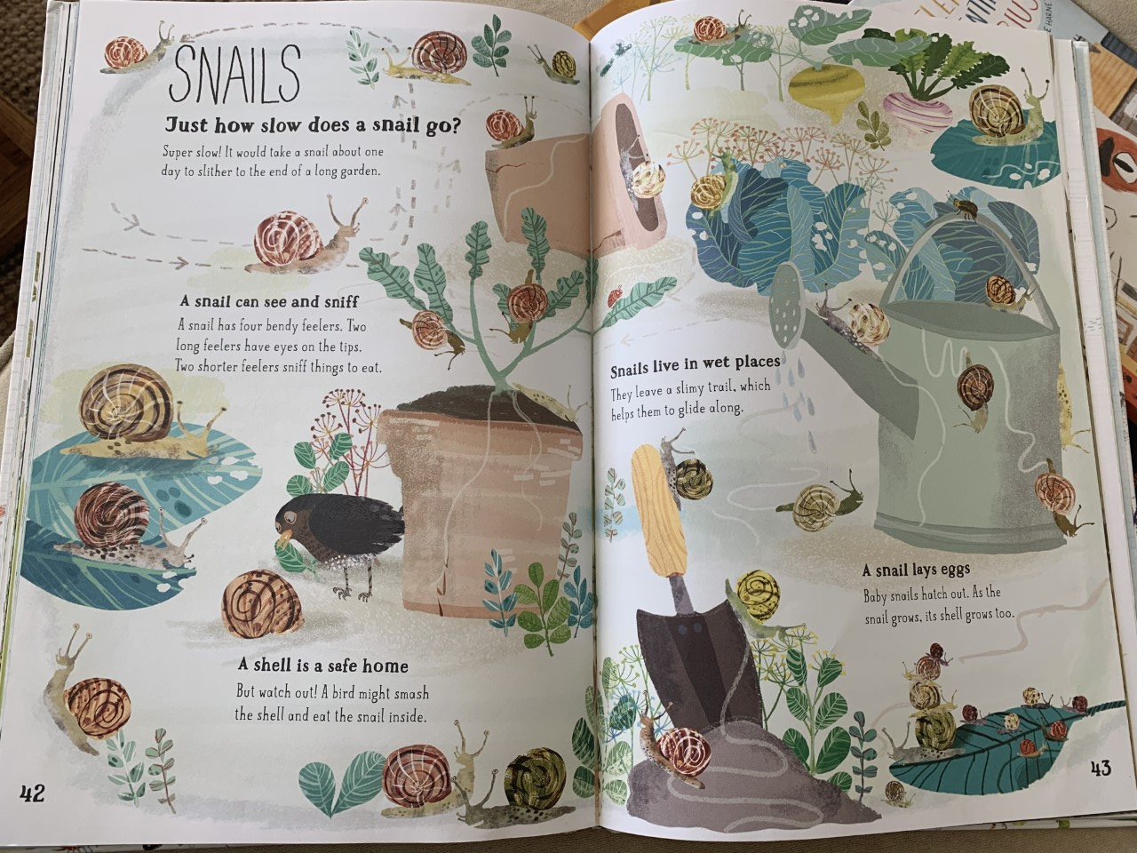
Challenge 1
Listen to the information and look at the pictures in the book.

Slide 25
Challenge 2
Support your child to read (or/ and listen to) the text. Encourage your child to revisit the text after reading the question.
What do the two shorter feelers do?

Slide 26
Challenge 3
Support your child to read (or/ and listen to) the text. Encourage your child to revisit the text after reading the question.
Tick the box that is true.
A shell is a…
bedroom
safe home
time machine

Slide 27
Challenge 4
Support your child to read (or/ and listen to) the text. Encourage your child to revisit the text after reading the question.
What grows with the baby snail?

Slide 28
Friday
Reading

Slide 29
Friday
Today child is revisiting and learning to…
Listen carefully to an information book and retrieve information.
Do this by…
Listening carefully to the information book.
Read the comprehension questions and retrieve information from the text.
Order a sentence to make it make sense.

Slide 30
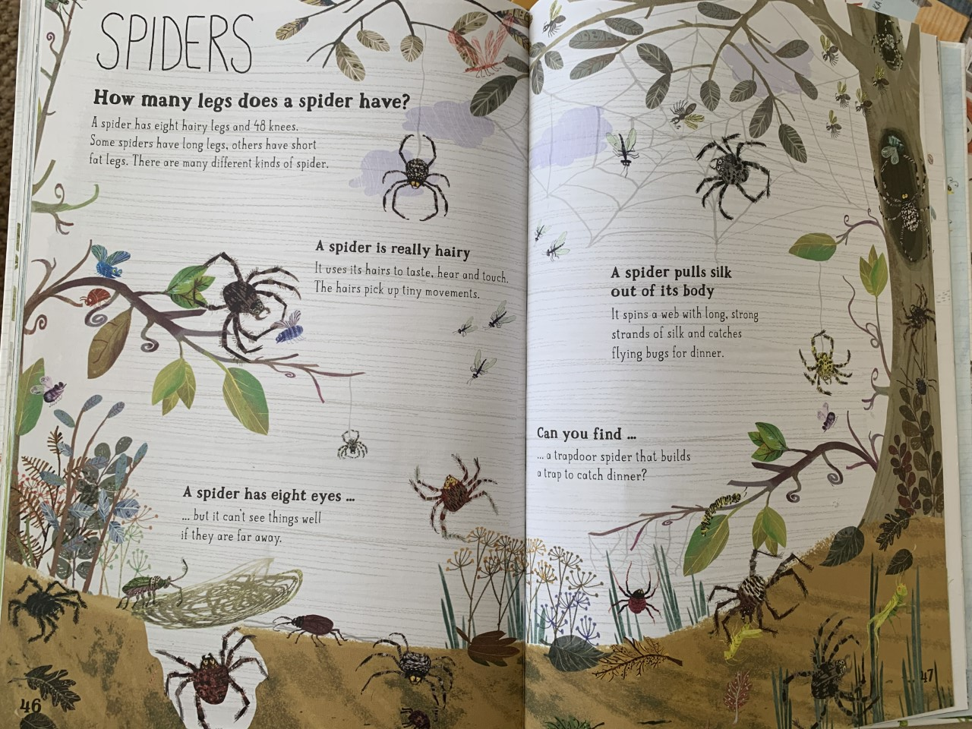
Challenge 1
Listen to the information and look at the pictures in the book.

Slide 31
Challenge 2
Support your child to read (or/ and listen to) the text. Encourage your child to revisit the text after reading the question.
How many knees do spiders have?

Slide 32
Challenge 3
Support your child to read (or/ and listen to) the text. Encourage your child to revisit the text after reading the question.
Tick all of the boxes that are true
Spiders use their hairs
to
Hear
Taste
Touch

Slide 33
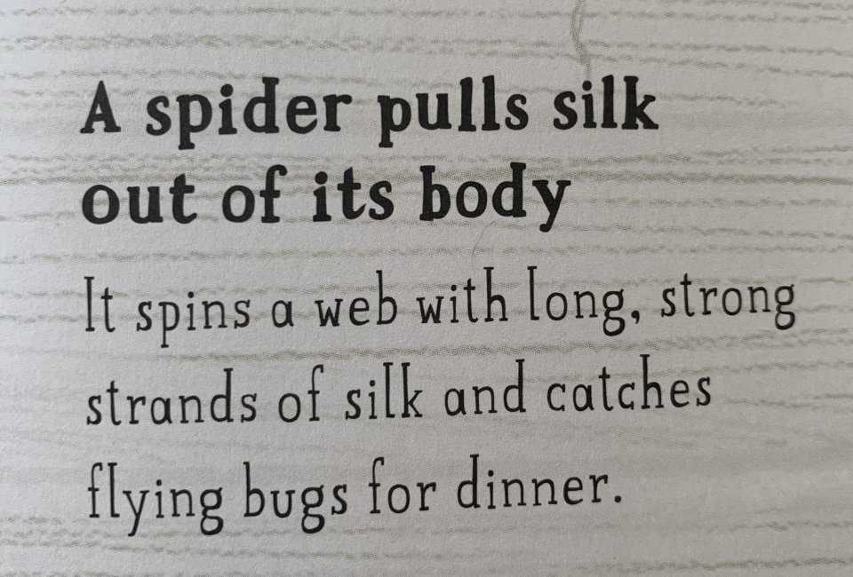
Challenge 4
Support your child to read (or/ and listen to) the text. Encourage your child to revisit the text after reading the question.
Pick two words that describe the spiders silk.

