Slide 1
Title: Merchant of Venice: Themes
Starter: what is a theme?
Challenge: what is a motif?
Themes: the main ideas that appear repeatedly throughout the text. They are often ideas (concepts) that everyone will understand.
Motifs: images, words or ideas that are repeated and help the audience to understand the theme.
Aim: to explore the themes present in the Merchant of Venice
All: will be able to identify main themes in the play
Most: will be able give an example of each of the main themes
Challenge: can you link the character of Shylock to the themes, developing your understanding of the extent to which we feel sympathy for him?

Slide 2
What’s the theme?
Notes:
Love V hate

Slide 3
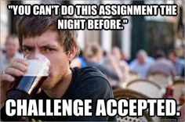
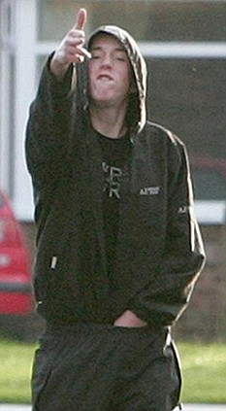
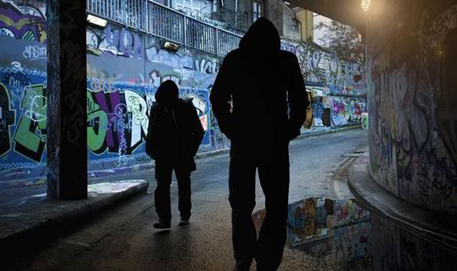
What’s the theme?
All students are lazy
All teenage boys are thugs
Prejudice: an unjustified or incorrect attitude (usually negative) towards an individual based solely on the individual's membership of a social group

Slide 4
What’s the theme?
Notes:
Money, wealth, trade, power

Slide 5
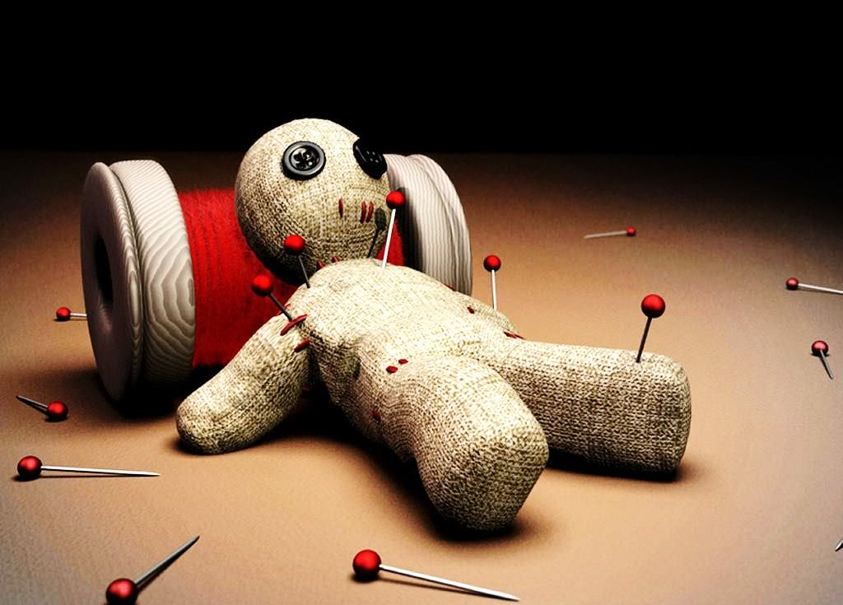
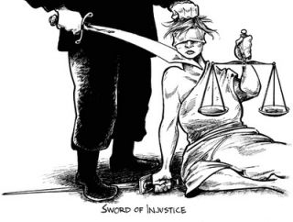
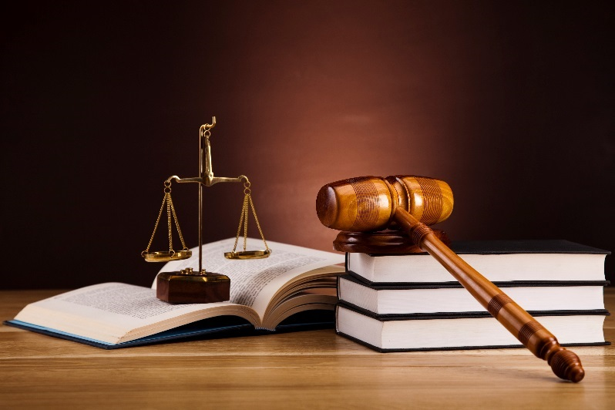
What’s the theme?
Notes:
Revenge and justice

Slide 6
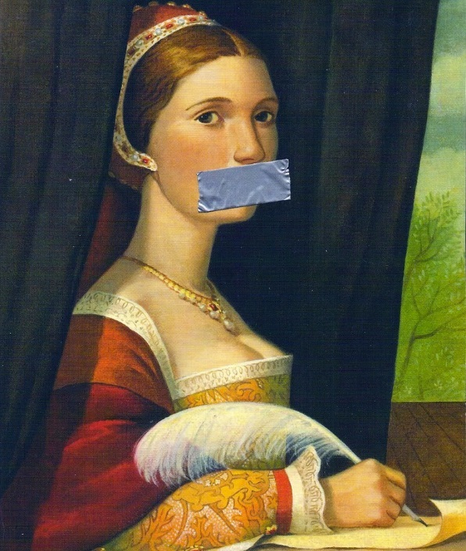
What’s the theme?
Notes:
Role of women

Slide 8
Plenary
In my opinion, the most important theme is…
For example, when the audience see …
It does / does not make the audience feel sympathy towards Shylock because…

